Slide 1
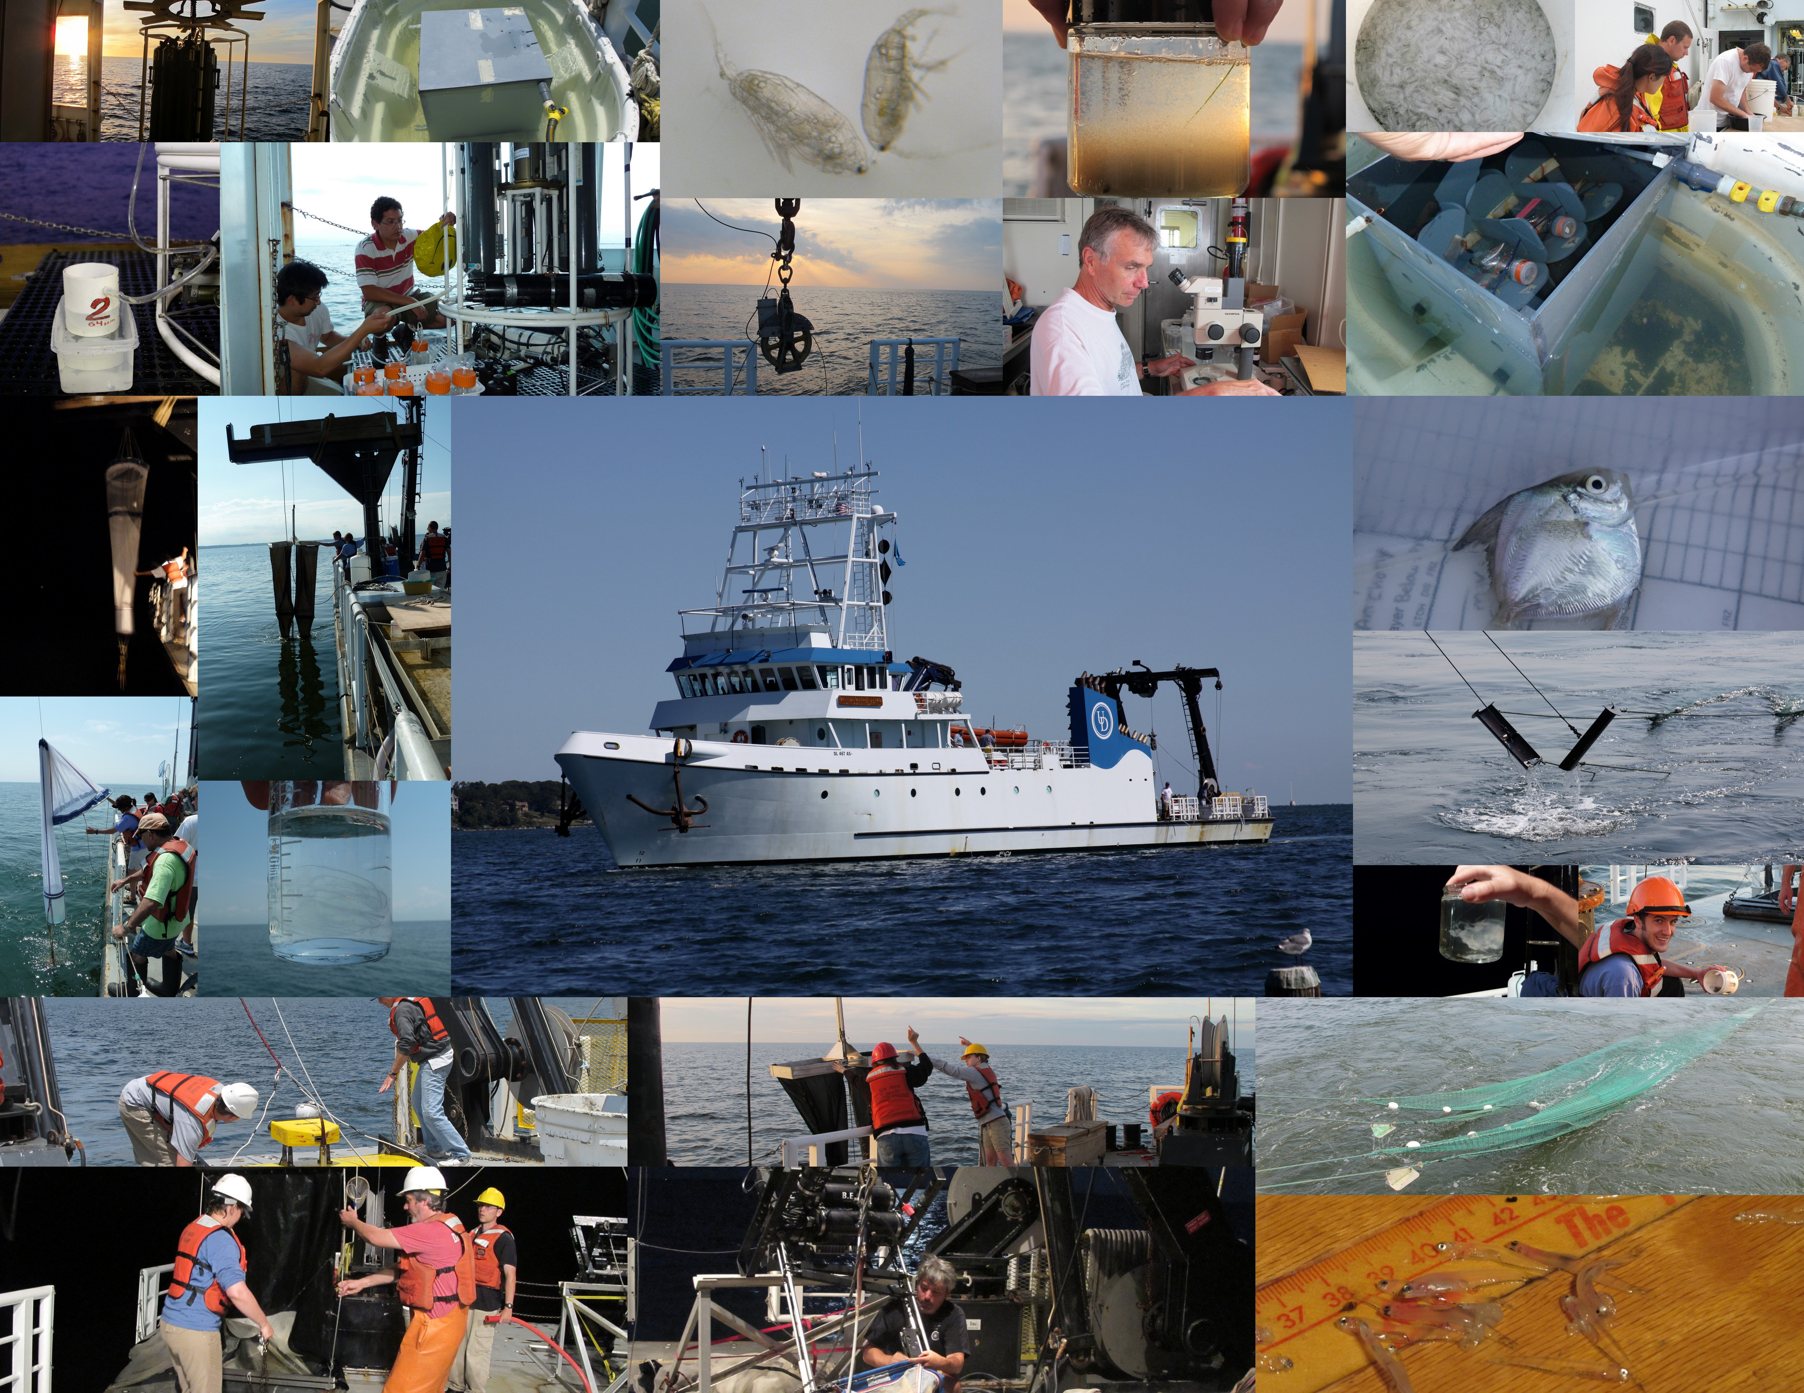
DeZoZoo Investigators Meeting
5 December 2012

Slide 2
What are we doing here today?
What we said we would do.
What we actually did.
What does it mean.
What and how do we tell people about it.

Slide 3
Our goal
Develop a mechanistic understanding of how the behavior and fitness of copepods is influenced by hypoxia.
How are these effects expressed in the population abundance, distribution and trophic dynamics?

Slide 4
Themes & Hypotheses
Behavior, Distribution, and Abundance
Organism Fitness
Copepod Mortality

Slide 5
Behavior, distribution, and abundance
Hypothesis I:
Low-oxygen bottom waters exercise control over the vertical distribution and migration behavior of copepods.
Copepods may either avoid hypoxic waters or they may be found in hypoxic waters at least part of the day, moving between layers of low-oxygen water and overlying normoxic water.

Slide 6
Organism Fitness
Hypothesis II:
Low-oxygen bottom waters reduce the fitness of copepods.
Low-oxygen bottom waters may directly reduce copepod fitness through physiological stress, but low dissolved oxygen also may indirectly enhance the fitness of copepods if their food is aggregated in layers within the oxycline.

Slide 7
Copepod Mortality
Hypothesis III:
Low-oxygen bottom waters increase mortality rate by directly killing copepods and their eggs.
Alternatively, hypoxic bottom waters may increase the rate of copepod mortality indirectly by enhancing trophic interactions between copepods and their fish and jellyfish predators.

Slide 8
Synthesis and comparative modeling
Individual based model of copepod foraging behavior in response to hypoxia
Based on Leising et al. (2005) and adapted for the Chesapeake and Acartia
Based on Gentleman et al 2009, Neuheimer et al 2010

Slide 9
2010: Dry

Slide 10
Hypoxia began in the upper bay and was prevalent by late May.

Slide 11
Hypoxia and even anoxia was well developed in August.

Slide 12
By late September hypoxia was beginning to dissipate.

Slide 13
2011: Wet

Slide 14
May 2011: CTD survey instead of Scanfish, but it’s already fresh and low DO

Slide 15
July 2011: Anoxic, all around

Slide 16
September 2011: Long scanfish survey, lots of low DO in upper bay…

Slide 17
September 2011, 2nd survey: Low DO returning

Slide 18
Some of the Microplankton and Mocness tow data

Slide 19
Microplankton biomass was high and composition differed between sites in May 2010
Normoxic
Hypoxic
Courtesy Diane Stoecker

Slide 20
Higher daytime oxygen, evidence of DVM at hypoxic site for A. tonsa
Due to equipment problems, limited data for normoxic site.

Slide 21
Microplankton biomass was lower and communities were more similar in August 2010
Normoxic
Hypoxic
Courtesy Diane Stoecker

Slide 22
DVM of A. tonsa was most prevalent at hypoxic site in summer

Slide 23
Microplankton biomass remained low and communities were similar in September 2010
Normoxic
Hypoxic
Courtesy Diane Stoecker

Slide 24
No evidence of DVM at normoxic station in Autumn for A. tonsa
Due to equipment problems, no data for hypoxic site.

Slide 25
Copepodites found in deep, hypoxic water more often than females

Slide 27
Other data: e.g. ADCP

Slide 28
Next: David, MIKE, Diane KATHERINE, Mary beth, Ed

Slide 29
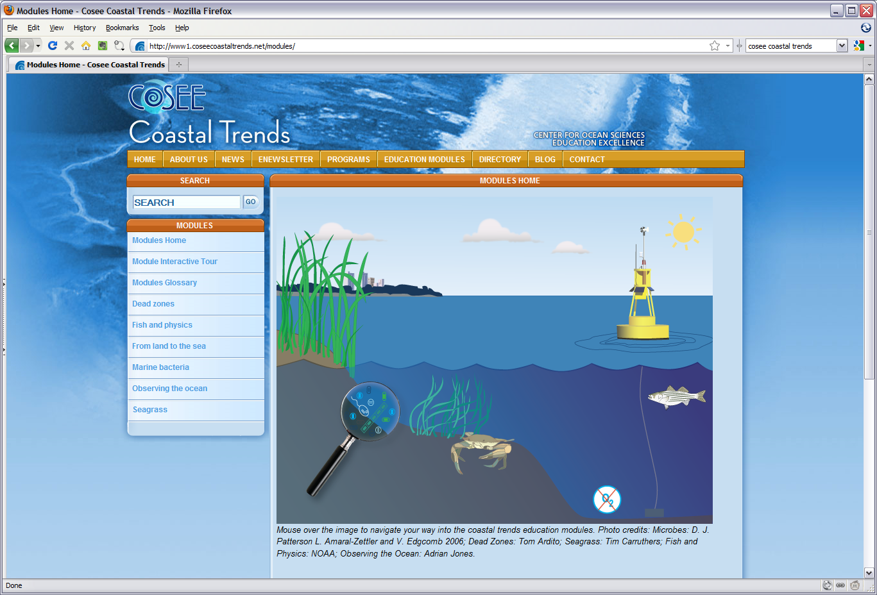
Expanding the horizons and expanding the parameters -”Sounds of Science” Beastie Boys 1989
Planning Science-Educator Partnership for summer 2011

Slide 30
Broader Impacts
COSEE Scientist-Educator Partnership program
Middle or High School teacher at HPL for 6-week residential program
Create an education module which will focus on zooplankton (e.g. copepods) and their survival in coastal systems.
Comprehensive dissemination of the modules via the web, hands-on workshops, and conferences
www.lifeinthedeadzone.org

Slide 31
2 Scientist-Educator Teams
Each team consists of undergrad from Hampton University and a Teacher
Plankton:
http://teachoceanscience.net/teaching_resources/education_modules/plankton_-_aquatic_drifters/get_started/
Marine Food Webs:
http://teachoceanscience.net/teaching_resources/education_modules/aquatic_food_webs/get_started/

Slide 32
Papers!

